Slide 1

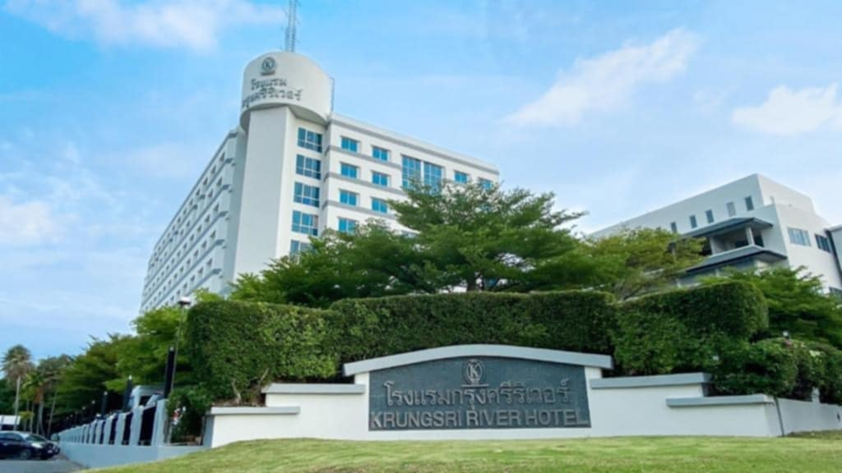
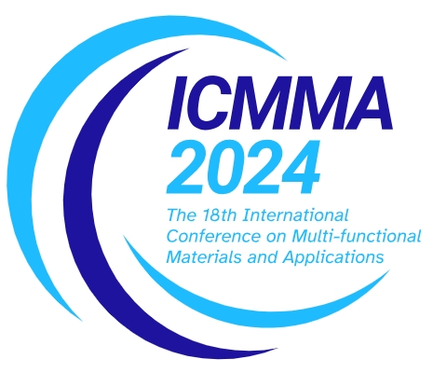
The Title of the Paper in 18th International Conference on Multi-Functional Materials and Applications (ICMMA 2024) (30 point font, bold letters)
ID: POXX
Names of the Authors (24 point font, bold letters, one line only)
Authors’ Affiliation(s) (20 point font, one line only)
Poster Size: 90x120 cm
Abstract (22 point font, bold letters)
All papers submitted to the ICMMA 2024 are also required to be displayed as posters even the papers have been assigned as oral presentation. Please use this document as a template to form the poster in which you can type your own text. (17
point font, single-spaced) and paste figures.
Keywords (22 point font, bold letters)
ICMMA; (one line if possible)
IV. Experiments
The ICMMA 2024 International Conference on Multi-Functional Materials and Applications (ICMMA 2024) will be held from 28 to 30 November 2024 in Thailand.
We are going organize “The 18th International Conference on Multi-functional Materials and Applications” on 28-30 November 2024 in King Mongkut’s Institute of Technology Ladkrabang (KMITL), Bangkok, Thailand. The Detail information of the conference is shown in our official webpage: https://icmma2024.org. In view of your reputation in the field of Chemistry, Physics, Materials Science and Engineering, Construction and Environmental Materials, we would like to invite you to participate in the conference, present and share your valuable research achievements to our participants.
I. Introduction (22 point font, bold letters )
This is the template for preparation of posters for International Conference on Multi-Functional Materials and Applications (ICMMA 2024). Please use this document as a sample of the conference poster.
ICMMA 2024 will produce final hard copies of all poster papers in a unified style. The PowerPoint template to produce your conference posters is available at
http://www.asemd.org/
II. Principle (22 point font, bold letters )
Describe the basic principle of your research works here.
The scope of the conference includes principally the following topics:
1. Strong Current and Large Scale
2. Applied Superconductivity
3. Superconducting Electronics
4. Superconducting Materials
5. Electromagnetic Materials
6. Electromagnetic Devices
7. Electric Power Devices
8. Electrical Machines
9. Energy Efficiency Devices
10. Power Electronic Devices and Circuits
11. Mechatronics
12. Control and Measurement
13. Computing and Informatics
Fig. 3. Ayutthaya, Thailand.
III. Theoretical Modelling
This is the template for preparation of posters for ICMMA 2024. Please use this
document as a sample of the conference poster.
V. Results and Analyses
There are many hotels surrounding the Phranakhon Si Ayutthaya Rajabhat University
The Krungsri River Hotel, 27/2 Moo 11 Rojchana Rd, Kamang, Phra Nakhon Si Ayutthaya, 13000, Thailand
ICMMA 2024 will not make contract-hotels for participants. However, if you need ICMMA 2024 help to book hotel, please inform us through Email
A. Template of Font (20 point font)
All the items in your poster should be presented as an uniform layout. Do NOT
change the font sizes and font colors in the template.
Move the mouse to the beginning of the last column of each paragraph, press the key of “Enter” to interrupt the last column, and then make it LEFT align.
Other columns in each paragraph are recommended to be JUSTIFY align.
B. Template of Figures and Tables
More Figures and Tables are preferred for your poster to present your
outstanding works in ICMMA 2024.
Try to make your Figures are transparent to suit the light-yellow
background of the poster. In addition, all the items in the Figures and Tables such as lines, words, symbols are recommended to be identical to the colour of the
TEXT in the template (dark green)
(1)
(2)
Fig. 4. Title of the Figure. (16 point font)
VI. Conclusion
1. Technical Tours
2. Post Conference Tours
(Detailed information will be updated later)
Fig. 1. Title of the Figure. (16 point font)
Fig. 2. Title of the Figure. (16 point font)
Table I. Heading of the Table. (16 point font)
Model | Feature extraction | Reprocessing | Classification
KNN | >200,000 flops | ~10 flops | ~200 flops
NN |  |  | ~10,000 flops
References (Optional)
[1] X.Y. Cole, Enter main references here, International Conference on Multi-Functional Materials and Applications (ICMMA 2024) , Nov 28-30, 2024.
[2] X.Y. Cole, How to prepare the poster in ICMMA, JMMP vol. 3, no. 1, pp. 1-4, 2022.
• Enter your acknowledgements or sponsors here. (Optional) (14 point font)
Author email: XXX@XX.XX
The 18th International Conference on Multi-Functional Materials and Applications (ICMMA 2024) , Ayutthaya, Thailand, 28-30 November 2024

